Slide 1


Slide 2

OUR MAIN GOALS

Slide 3
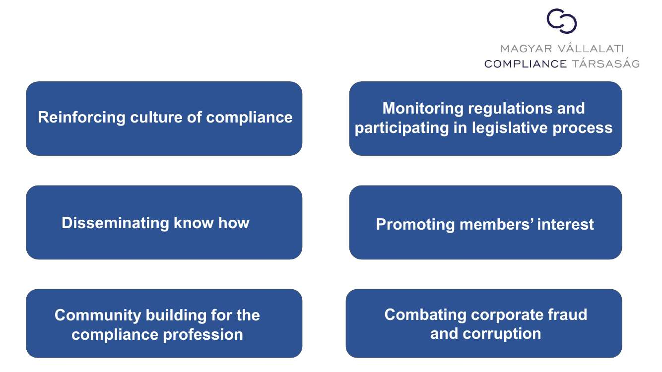
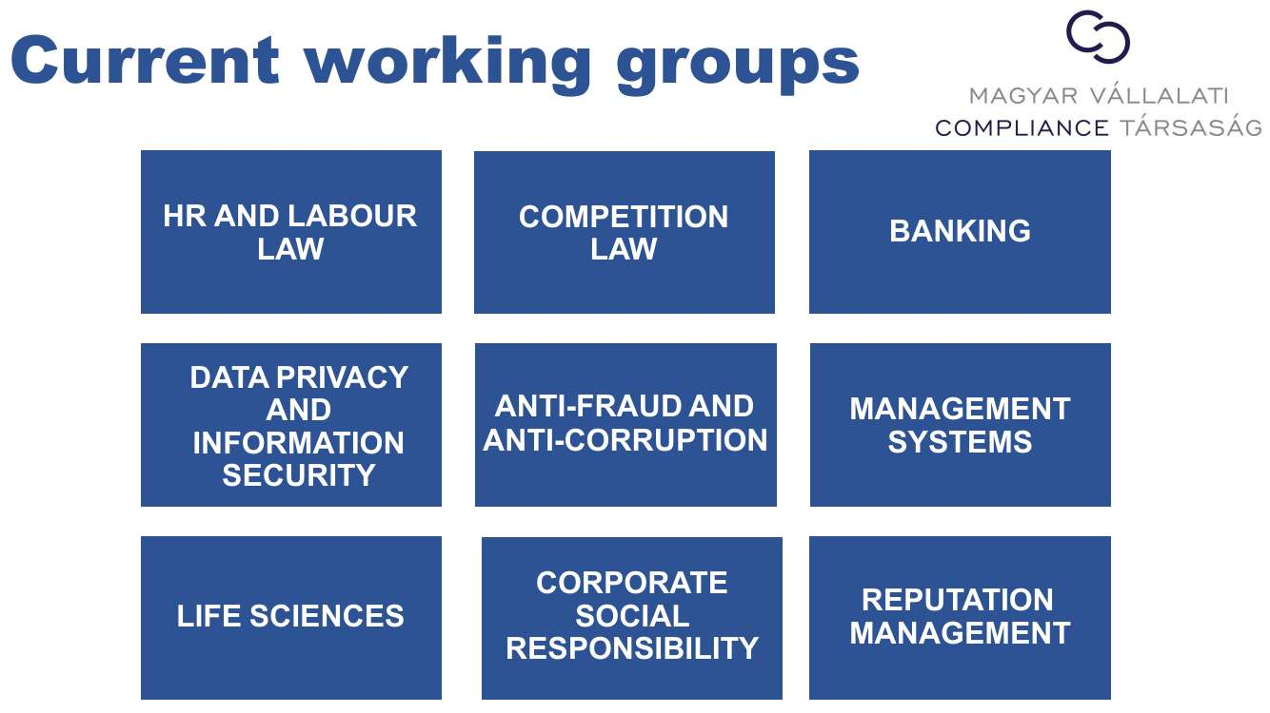

Slide 4

Added value provided for our members

Slide 5
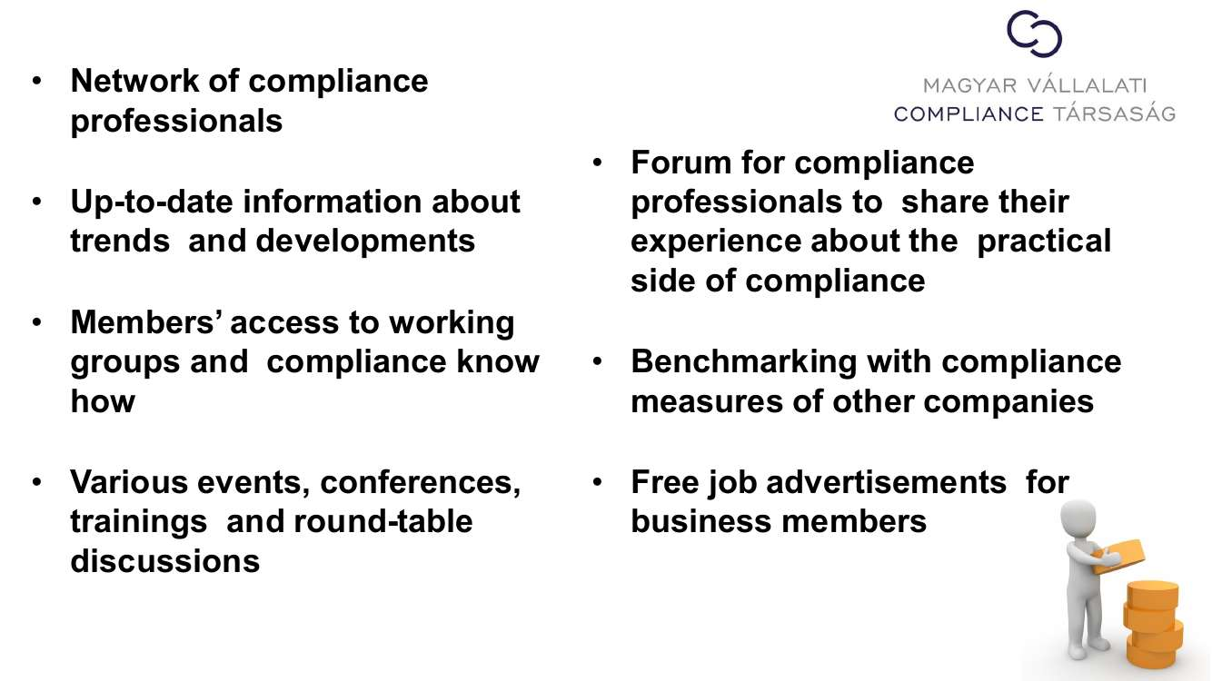

Slide 6

THE MAIN FOCUS OF OUR WORK

Slide 7


Slide 8
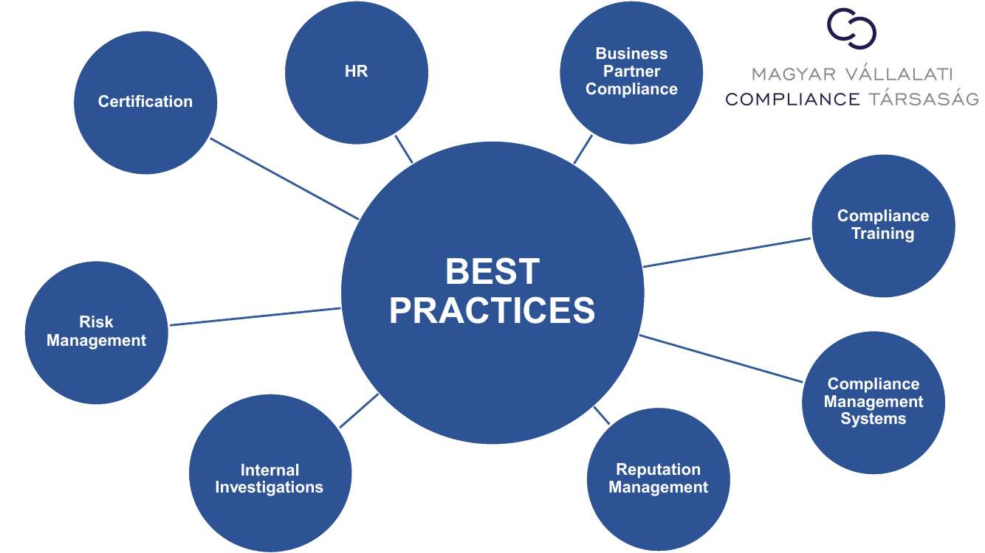

Slide 9
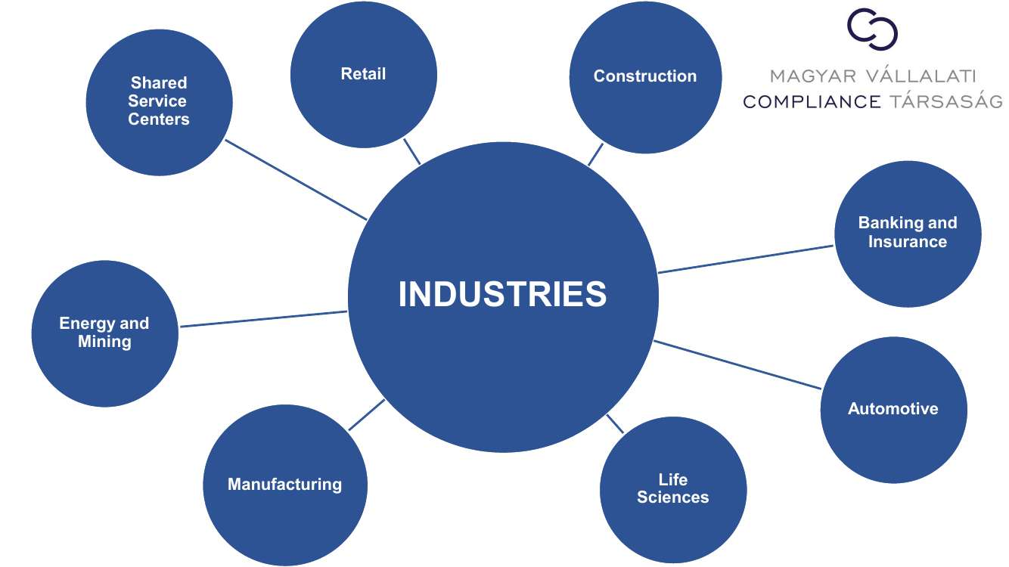

Slide 10

OUR WORKING GROUPS

Slide 11
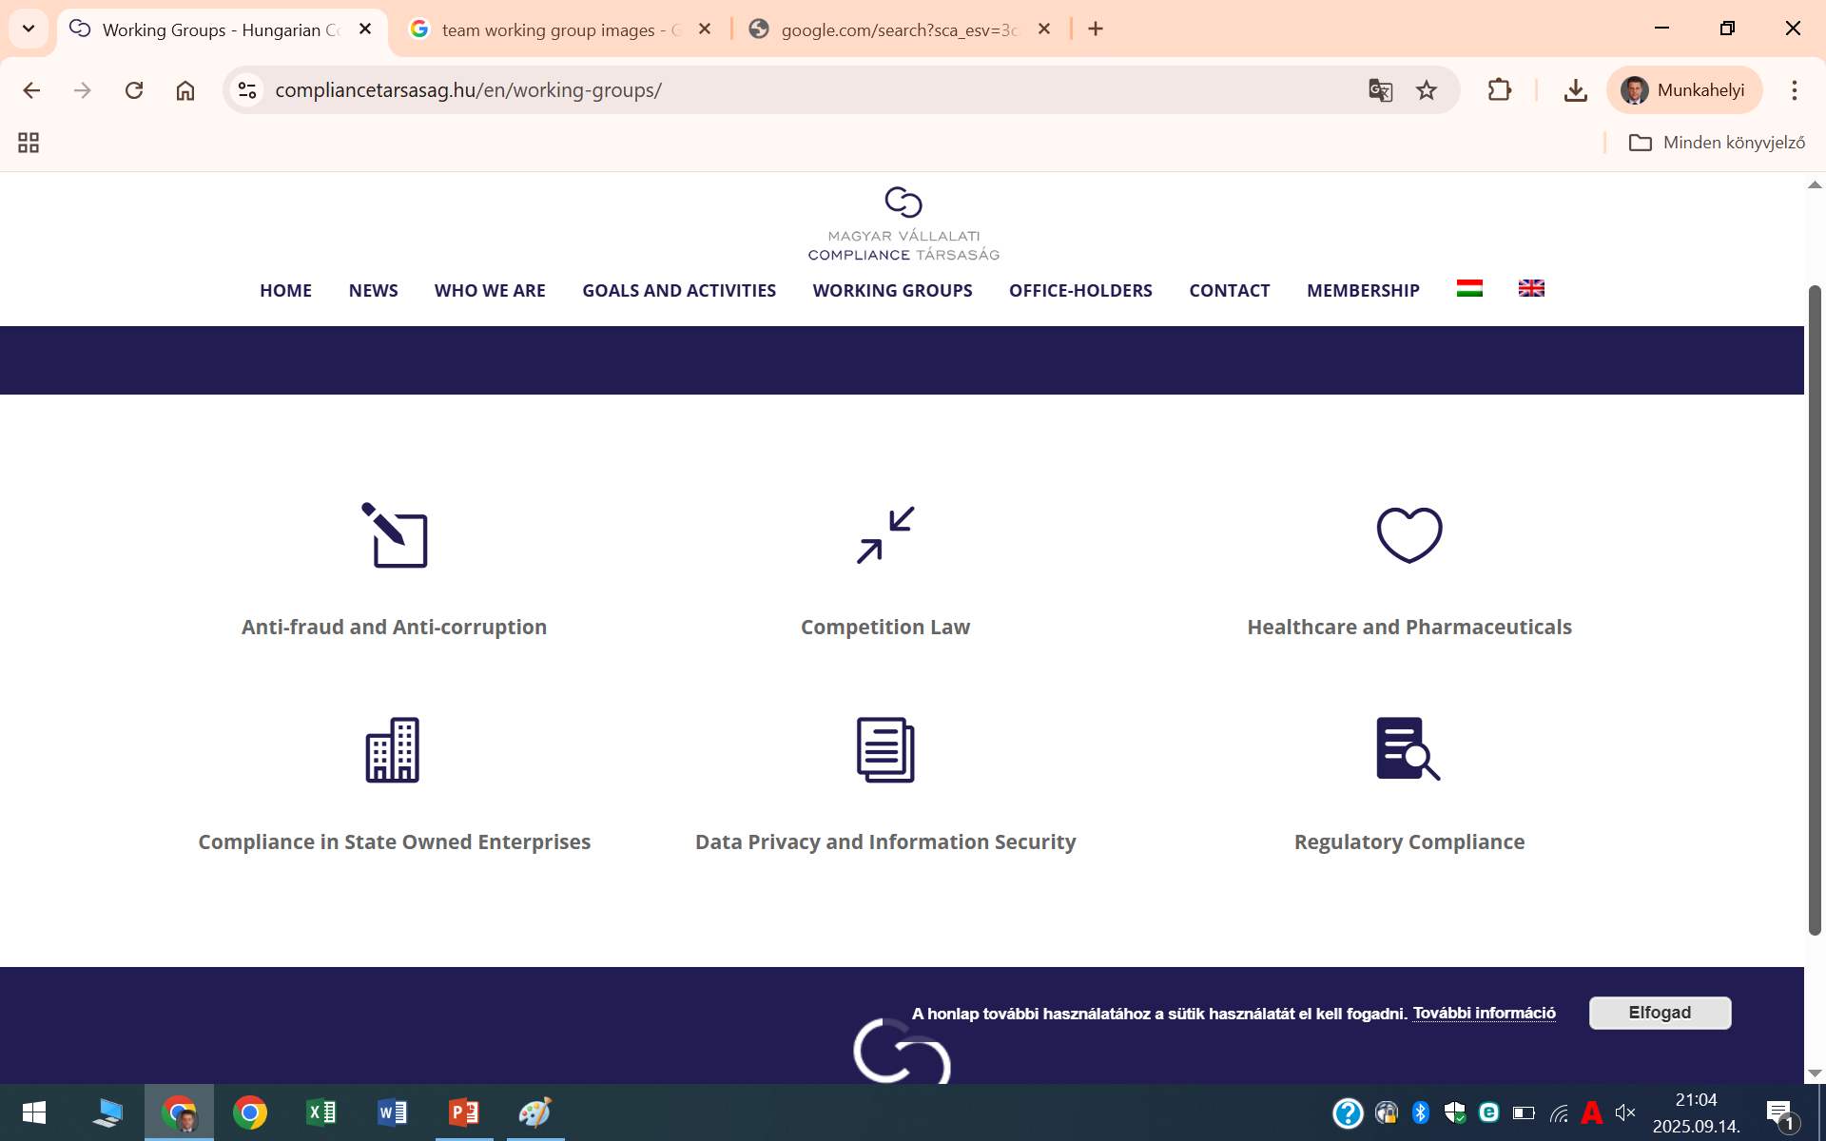
OUR WORKING GROUPS

Slide 12
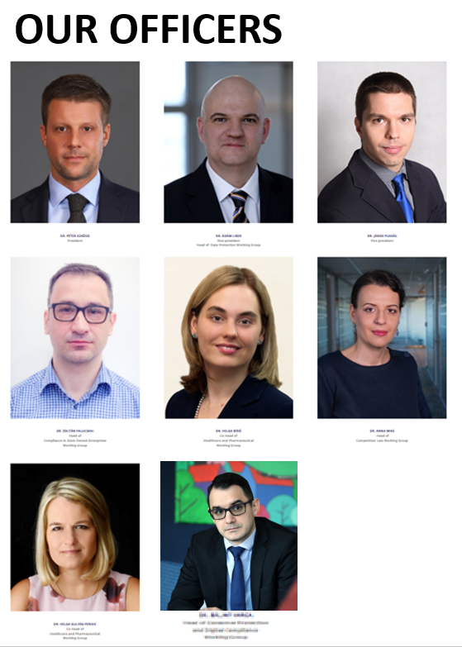
OUR OFFICERS

Slide 13
Thank you very much for your attention!
Our website: www.compliancetarsasag.hu

